Slide 1


Functional programming in concurrent and distributed systems
381-1-0112 | SM B 2017 | Tutorial 2
David Leon
Credit to Yehiel Zohar.

Slide 2
Introduction
Functional programming laboratory
Functional language – Erlang
No need to take care of mutual exclusion
Message passing based communication
Immutable (Unchangeable) variables
Development environment
Linux OS (Ubuntu)
Windows (Not supported)
Mac OS
Development environment on cloud
Azure (Microsoft) - Ubuntu
E2C AWS (Amazon) - Ubuntu AMI

Slide 3
Erlang Development
Based on Github repository:
65.9% of erlang is written by erlang.
13.4% of erlang is written in xml.
13.6% of erlang is written in c.
1.4% of erlang is written in cpp.
The rest some of other languages.

Slide 4
Install erlang
From Erlang site: http://erlang.org/doc/installation_guide/INSTALL.html
Type the following commands in terminal (CTRL+ALT+T): $ wget -O- https://packages.erlang-solutions.com/ubuntu/erlang_solutions.asc | sudo apt-key add – $ echo "deb https://packages.erlang-solutions.com/ubuntu focal contrib" | sudo tee /etc/apt/sources.list.d/rabbitmq.list $ sudo apt update $ sudo apt install erlang $ sudo apt-get install build-essential
On Windows (just a setup wizard).
To start an erlang shell run in terminal: erl
To execute the compiler run: erlc

Slide 5
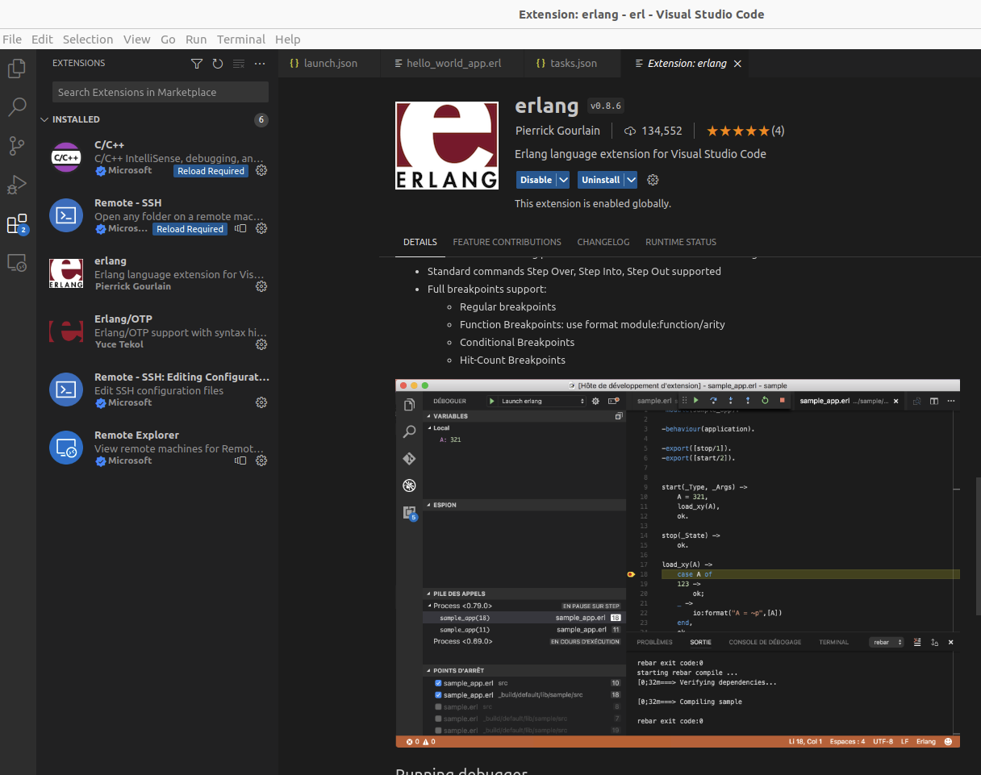
Development environment - VSCode
Recommended IDE for this course is VSCode + Rebar3.
How to debug and develop Erlang using VSCode.
Instructions for Ubuntu 22.04 installation:
Install VSCode https://code.visualstudio.com/
Install git: $ sudo apt install git
Install Rebar3 https://github.com/erlang/rebar3
Create a new rebar project, E.g., “erl_ide”:
$ rebar3 new app erl_ide
Open Vscode and open erl_ide directory.
Install the following extension: pgourlain.erlang
Create in vscode explorer the following directory:
“.vscode”
Copy into .vscode directory the following json files:
launch.json
tasks.json
Under src directory add you source code files.

Slide 6
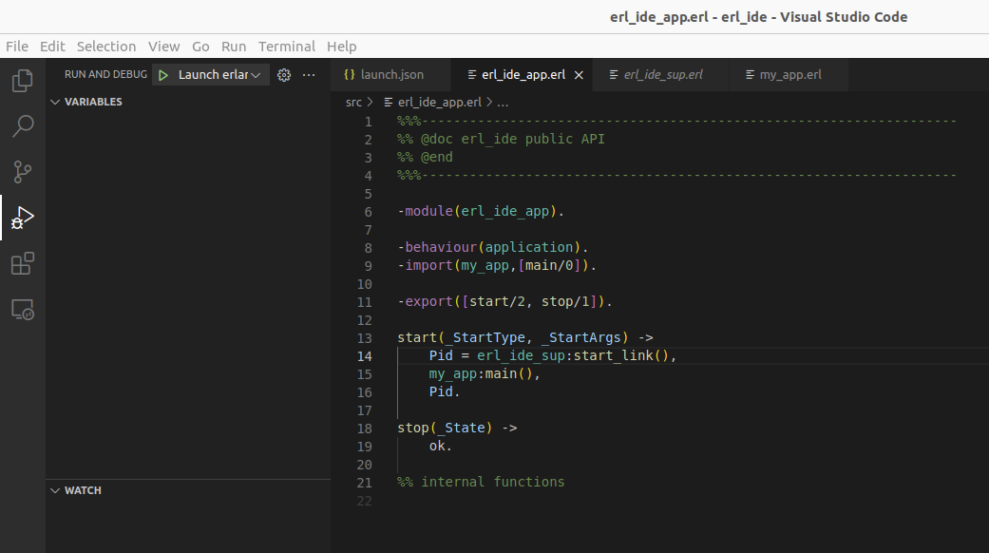
Development environment - VSCode
Edit erl_ide_app as follows to call a function for debugging.
In this example the debugged function is main in module my_app.
Remember! You should not submit a rebar3 project but a single source code erlang file!

Slide 7
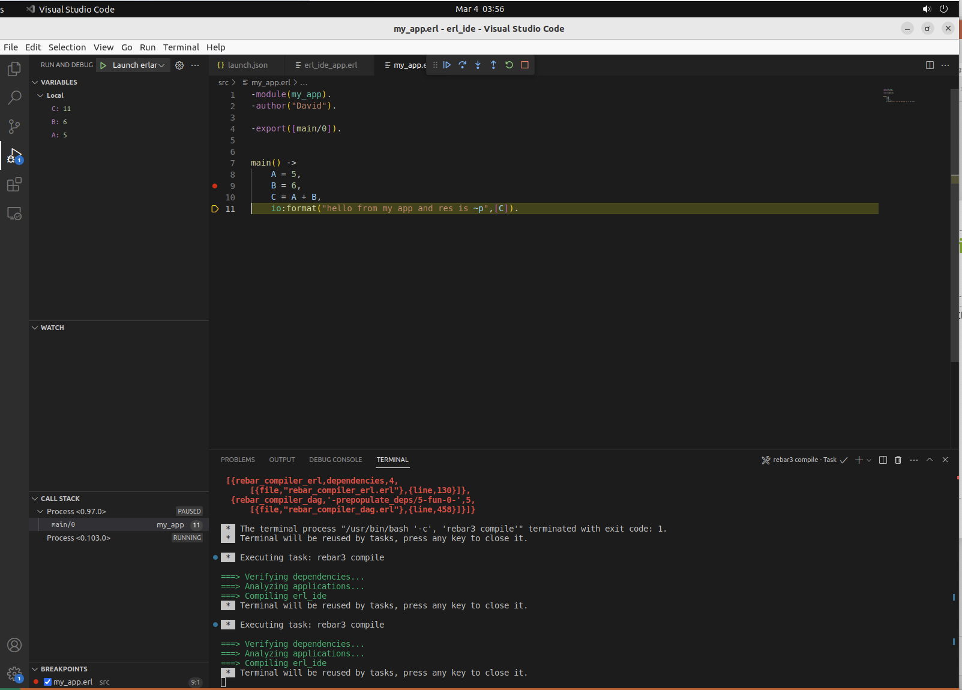
Hit Launch to start
Debuging after setting a breakpoint
Watch Local Vars

Slide 8
Development environment - VSCode
Pay attention that running program on IDE console will free resources at the end of the running while running the program on erlang shell won’t free resources automatically.
The exercises in this course will be tested on Linux – Ubuntu only (the same versions of Linux and erlang that are installed on computers in lab). No consideration for those student who didn’t check their exercises on Linux Ubuntu.
The computers in lab are the best for quality check before submission.

Slide 9
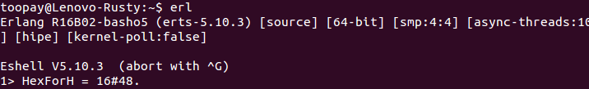
1# Erlang Shell
Modern languages, for example Erlang and Python contain shell for simple command testing without compiling erl/py files and then running.
Erlang establishes a VM that allows you to run your scripts and commands
To start the shell in Linux, open a terminal (CTRL+ALT+T) by just typing in erl
Expected result:
An expression is executed once you hit the “enter” key
Expressions can be separated with commas: “,”
Only the last result will be shown
Expressions are ended with “.”

Slide 10

1.1# Erlang Shell
Representing numbers is intuitive
1 + 54.
22 * 2.
15 - 8.
8 / 5.
8 div 5.
8 rem 5.

Slide 11

1.2# Shell
Variables begin with an uppercase letter or underscore (_)
As long as you do not change its assigned value, you will be fine
One.
One = 1.
Uno = One = 1.
Two = One + One.
Two = 2.
Two = Two + 1.
_Two = Two + 1.
two = 2.
Why did the two commands return an error?
What about the before last one? Was it a successful assignment? What is the value, then?
Notes:
ההשמה בלפני אחרון מצליחה כי זה משתנה!

Slide 12
1.3# Erlang Shell
Atoms are constants with their own name for value
An atom starts with a lowercase letter if it contains only alphanumeric characters, underscore (_), or @. Otherwise, it should be enclosed in single quotes (')
atom.
atom_1.
atom_1@bgu.
‘Atom are great!’.
atom = ‘atom’.

Slide 13
1.4# Erlang Shell
Boolean expressions and operators are used to compare items, and are similar to other languages
true and false.
false or true.
true xor false.
not false.
not (true and false).

Slide 14
1.5# Erlang Shell
Testing equality is simple, but slightly different than other languages
“==“ in Erlang is “=:=“
“!=“ in Erlang is “=/=“
5 =:= 5.
1 =:= 0.
1 =/= 0.
“==“ and “/=“ in Erlang are used for numerical comparison
5 =:= 5.0.
5 == 5.0.
5 /= 5.0.
Operators “>”, “<“, “>=“, “=<“ are same as in other languages

Slide 15
1.6# Erlang Shell
A tuple is a way to organize data by grouping together many terms when you know how many there are.
Point = {4,5}.
{X,Y} = Point.
What would be the values of X and Y at that point?
{X,4} = Point.
{X,_} = Point.
Can you explain the last result?

Slide 16

1.7# Shell
Lists can contain anything! (including nothing)
[1, 2, 3, numbers, [4,5,6], 5.34, {4,5}].
[97, 98, 99].
Can you explain the last result?
Strings are lists and the notation is absolutely the exact same!
Erlang will print lists of numbers as numbers only when at least one of them could not also represent a letter
[1,2,3] ++ [4,5].
[1,2,3,4,5] -- [1,2,3].
hd([1,2,3,4]).
tl([1,2,3,4]).
[Head|Tail] = [1,2,3,4].
What are the values of “Head” and “Tail” now?

Slide 17
2# Modules
What is a module?
Module is a group of functions in a single file, under a single module name
A module name must start with a lowercase letter and must be the same as the name of the file that contains it
A module name must be unique
Erlang provides some modules that contain common operations
lists, io, erlang, etc.
All these modules are documented in http://www.erlang.org/doc.html

Slide 18
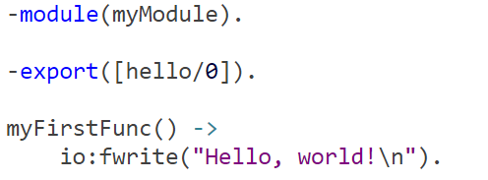

2# Modules
Let’s write a new module, step by step
Open a new file named “myModule.erl”
Declare the module name
Declare the list of functions that that can be called from the outside world and their arity
Write the functions

Slide 19
2# Modules
Now compile and call the function we implemented
Open a new terminal window (Alt+Ctrl+T)
Start Erlang shell By typing “erl”
Change the directory to where you have saved the module file using function cd/1
Compile the module
Call function hello/0
Compilation of multiple modules in current directory in erlang shell type: cover:compile_directory().

Slide 20
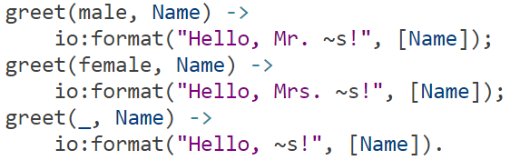
3# Functions
Pattern matching is also used when writing functions
Calling greet/2 with different arguments may execute different code
Different implementations for the same function and arity are separated with semi-colon (;)

Slide 21
4# Erlang Code
Erlang uses two types of files
.erl code file, contains modules
.hrl header file, contains defines, constants, declarations
Two ways to mark a comment in Erlang
% line comment
%% file/function comment

Slide 22
Erlang Header Files
Like in C/Cpp Erlang also supports in headers.
Assuming that there is a header file called “usr.hrl”
In erl file use: -include(“usr.hrl”).

Slide 23
Macros in Erlang
Like #define in cpp we are able to use macros in erlang:
-define(Pi, 3.14).
Then in code use “?” to refer to a pre defined macro:
A = ?Pi.
A =:= 3.14 (It will be true)

Slide 24
Lets practice
No submission is needed for this exercise.
Open Ubuntu and create a new erl file by gedit.
Create new module in erlang and call it calc.
Implement the following functions:
calc(plus,A,B) ->
calc(substraction,A,B)->
calc(multiply,A,B)->
calc(division,_,0)->
calc(division,A,B)->
Export the function and test this module on erlang shell.
Good Luck

Slide 25
Lets practice
Now implement pow on integers only
calc(pow,A,B)->
Note: If you need multiplication operator you must use your own which means:
Don’t use “ * ” but call the function calc(multiply,A,B).
Export the function and test this module on erlang shell again

Slide 26
5# Submission Procedures
Only a single .erl file to be submitted
Filename format: ex2_<ID>.erl
Where <ID> needs to be replaced with your ID number
Your code MUST be well documented (you will lose some points if not)
Functions’ names must be identical to the ones defined in exercise
Same as for the arity
Same as for the output format
Only the tested functions needs to be exported
Internal functions MUST NOT be exported
Assignments will be tested automatically in Erlang shell in Linux
Do yourself a favor and test this assignment 1000 times before submitting and pay big attention that the output of your program is exactly the same as you have been asked for.
The grade is final and unfortunately no appeals.

Slide 27
5# Submission Procedures
Relevant questions can be asked only in the forum in moodle site or in reception hours.
Uploading code to the forum is forbidden!!!

Slide 28
Exercise 2
Implement the following functions, without using module lists or using guards, if/case, ++ or --
findKelem(List,K)
Returns the K’th element of List. In case of an error, it should return an atom, notFound
Examples
findKelem([1,2,3,4,5],5) → 5
findKelem([1,2,3,4,5],6) → notFound
findKelem([],1) → notFound
reverse(List)
Reverse List’s items
Examples
reverse([1,2,3,4,5]) → [5,4,3,2,1]
reverse([]) → []

Slide 29
Exercise 2
deleteKelem(List,Elem)
Deletes all instances of Elem from List
Examples
deleteKelem([1,2,1,2,1],1) → [2,2]
deleteKelem([1,2,1,2,1],3) → [1,2,1,2,1]
deleteKelem([],1) → []
addKelem(List,K,Elem)
Adds Elem to List in K’th place. Assume valid input
Examples
addKelem([1,2,3,4,5],3,new) → [1,2,new,3,4,5]
addKelem([1,2,3,4,5],6,new) → [1,2,3,4,5,new]
addKelem([],1,new) → [new]

Slide 30
Exercise 2
union(List1,List2)
Returns the union of these two lists and removes multiple instances from both lists
Examples
union([],[]) → []
union([1,2,3],[2,3,4]) → [1,2,3,4]
union([1,2,2,5],[1,2,3]) → [1,2,5,3]

Slide 31
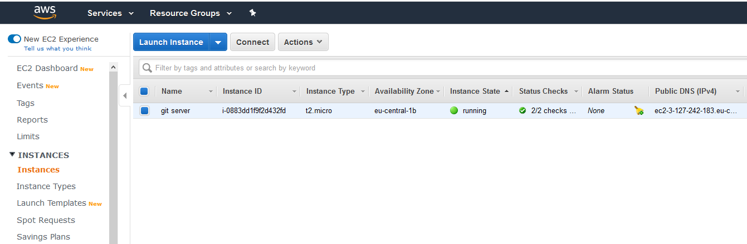
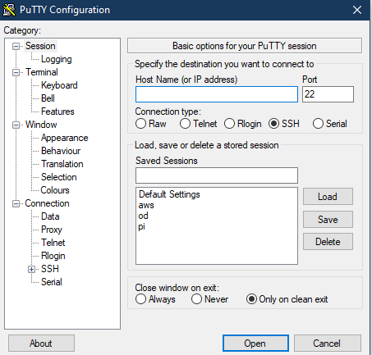
Working on Amazon Cloud Service (Optional)
Open a free tier instance for free.
Connect through SSH Useful links: Linux - https://docs.aws.amazon.com/AWSEC2/latest/UserGuide/AccessingInstancesLinux.html Windows (Putty) - https://docs.aws.amazon.com/AWSEC2/latest/UserGuide/putty.html
Launch an instance of Ubuntu
Remember to select the free tier t2.micro. Free tier is available for limited time, pay attention to avoid Unintentional expenses.
Install Erlang: https://tecadmin.net/install-erlang-on-ubuntu/

